Slide 1
Barracuda | Lightstream | AWS Dev Day:
Automated and simplified app security

Slide 2
Agenda
Modern Applications – Security
Cloud Application Protection 2.0 Introduction
Barracuda WAF | Automation & Deployment
AWS Cloud Formation & Cloud Formation Templates (CFT)
Barracuda WAF | Application Security
Hands On – Attack Lab Session
Next Steps

Slide 3
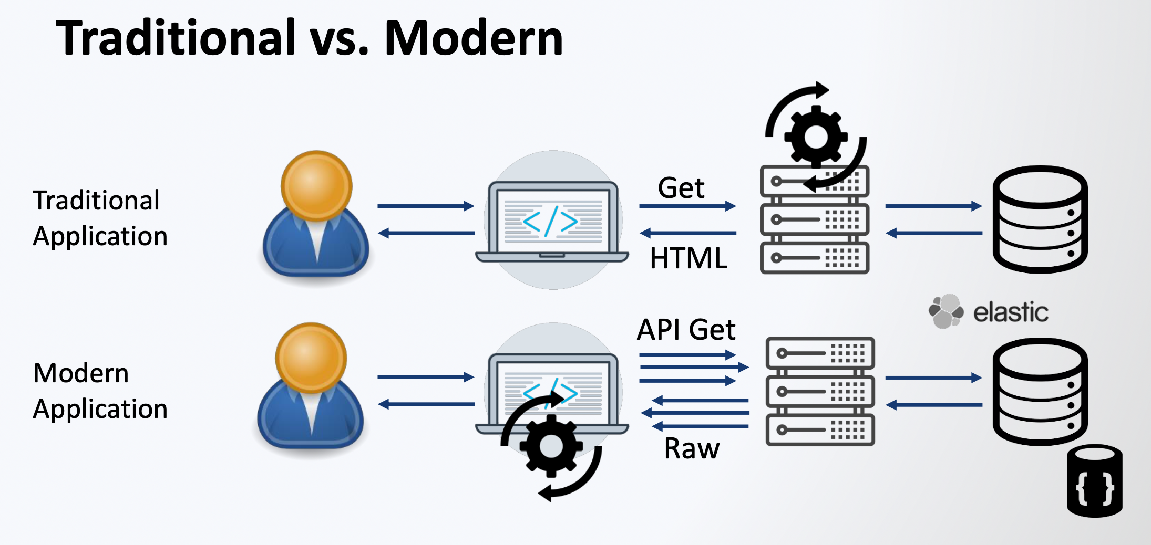
Modern Apps – Deployment and Security
Notes:
Modern Applications are developed with an API First approach. This enables a clear separation between the data handling logic and the client side rendering logic. Since we now have a proliferation of client devices that come in different forms and shapes, the API first approach design enables independent design decisions for client applications. This also introduces security problems at 2 levels.

Slide 4
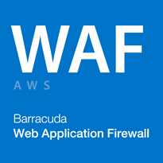
Barracuda Web Application Firewall
Ensure Protection from Web Attacks and DDoS
Block advanced Bots
Protect APIs and Mobile Apps
Control Access and Authentication
Secure App Delivery and Increase Availability
Automate and Orchestrate Security

Slide 5



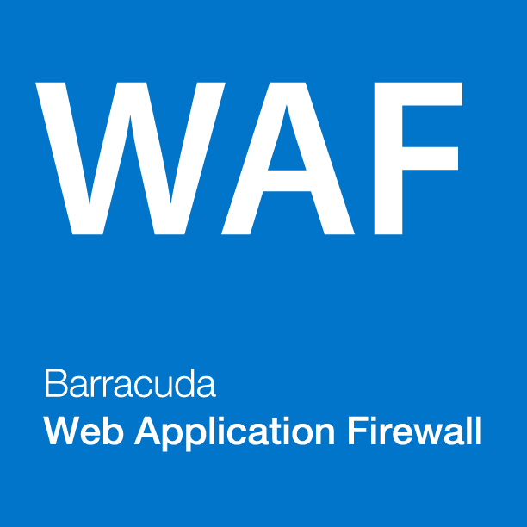




Cloud Application Protection
Comprehensive Application Security
OWASP Top-10 Attacks
Application DDOS
Data Loss Prevention
Credit Card Numbers
Social Security Number
Custom Patterns
Proactive Defense
Application Cloaking
Geo-IP Control
Inbound Inspection
Outbound Inspection
Authentication & Access Control
Logging & Reporting

Slide 6
Cloud Application Protection
Cloud Detection & Services Layer
(Threat Intelligence, Application Scanning Services)
Shared Services
Ease of use
Reporting & Analytics
Virtual Patching
Bootstrapping & Rehydration
Auto Scaling
Access Control
Authentication
Authorization
OWASP Top 10 & More
Protection for APIs
Advanced Bot Protection
DDoS Prevention
Advanced Threat Protection
Security
App Delivery
Load Balancing
Caching & Compression
Content Routing
Traffic Encryption
API Driven and
DevSecOps ready
On Premises | Hosting Service Providers | Public Cloud
HW / Vx
| Standalone / SaaS
| IaaS / PaaS

Slide 7
CAP 2.0 Protects Against All Threat Vectors
Powerful Protection
Client-side protection
Active Threat Intelligence
JSON Web Token security
HTTP/2 end-to-end
WebSocket Security
Easy to Use
Auto-Configuration Engine
Terraform Provider
New Configuration Templates
Protect any App Environment
Containerized WAF
CDN

Slide 8
Barracuda WAF | Automation & Deployment

Slide 9
Cloud Automation
Deployment
Management/Configuration
Deployment | AWS CloudFormation
Management

Slide 10






API and Orchestrated Deployment
For Automation, DevSecOps, CI/CD…
AWS CloudFormation
https://github.com/barracudanetworks
https://forge.puppet.com/barracuda
https://campus.barracuda.com/product/webapplicationfirewall/api/

Slide 11
AWS Cloud Formation
AWS Cloud Formation is an AWS service that helps you easily deploy and pre-configure several resources at once.
CloudFormation Templates (CFT) are JSON or YAML text files with all blueprints for building your AWS resources
AWS CloudFormation uses the template to build out all of the resources into a single “Stack”.
Today’s lab ‘stack’ includes all the resources required to run a web application: pre-configured Barracuda WAF, a web server, security groups, and networking rules.

Slide 12
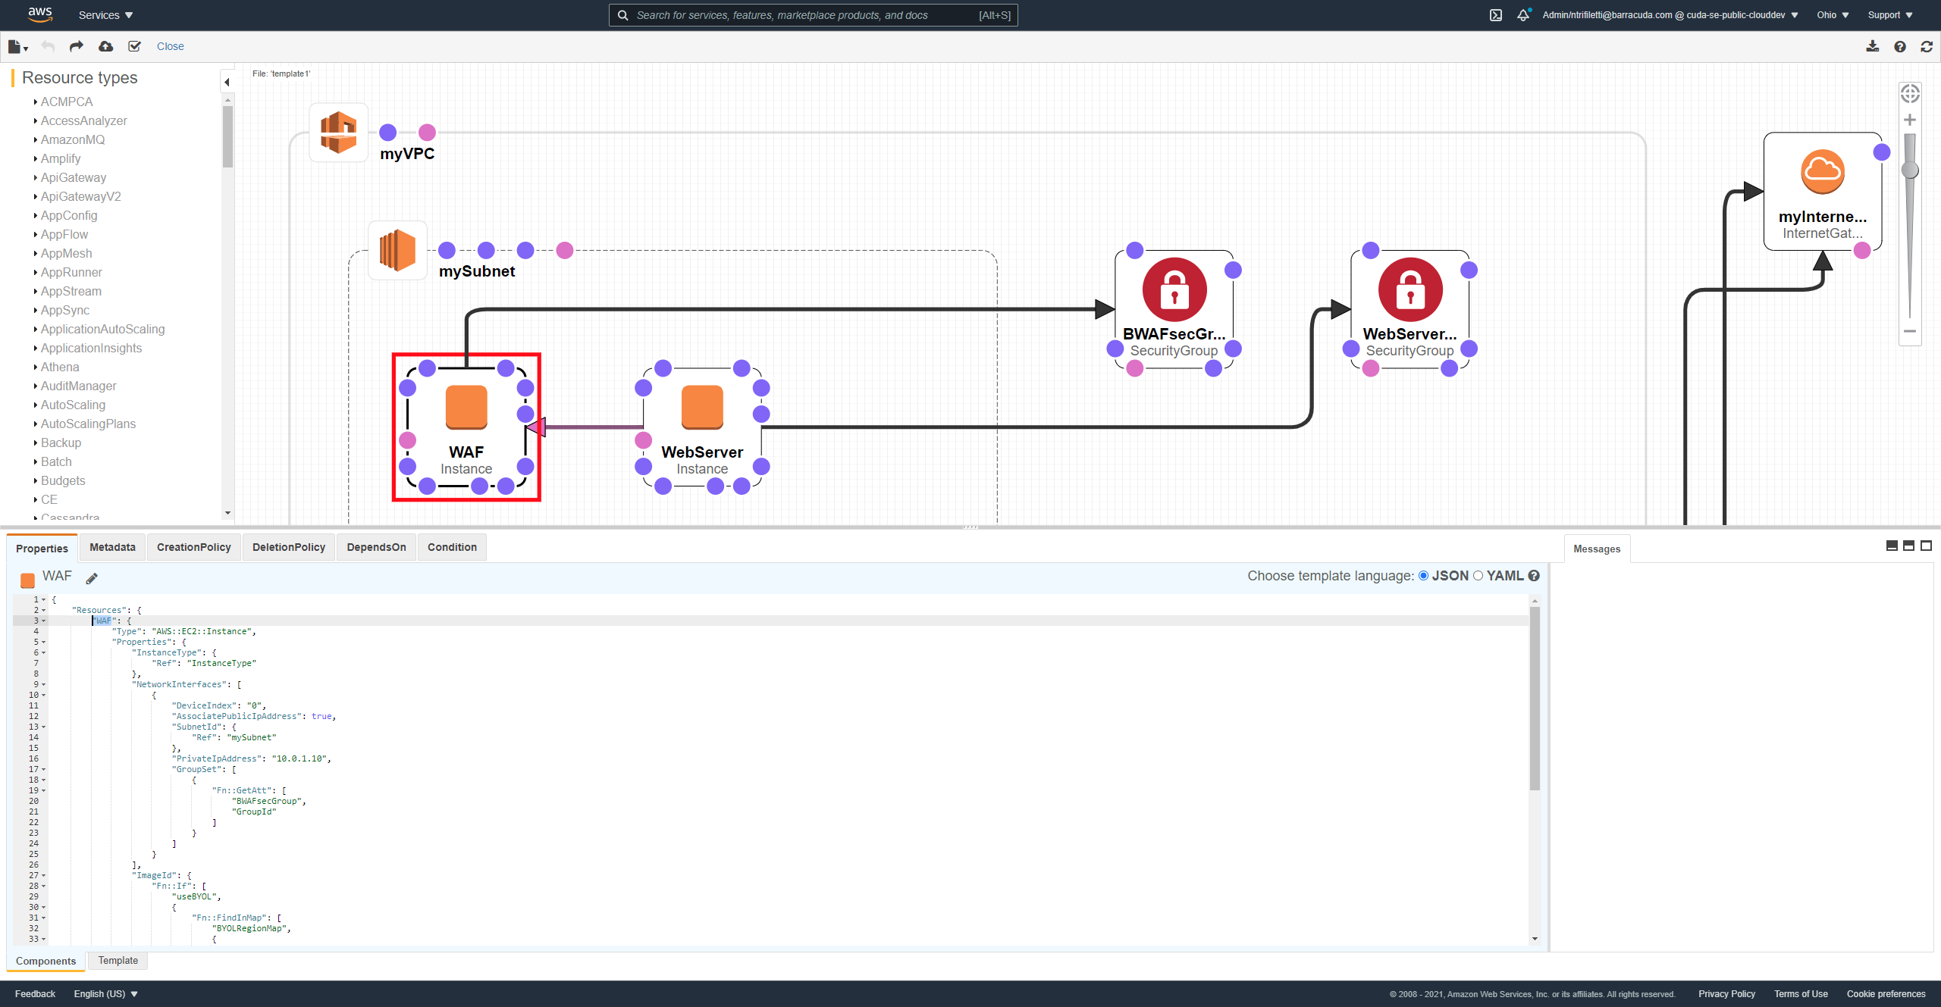

Slide 13
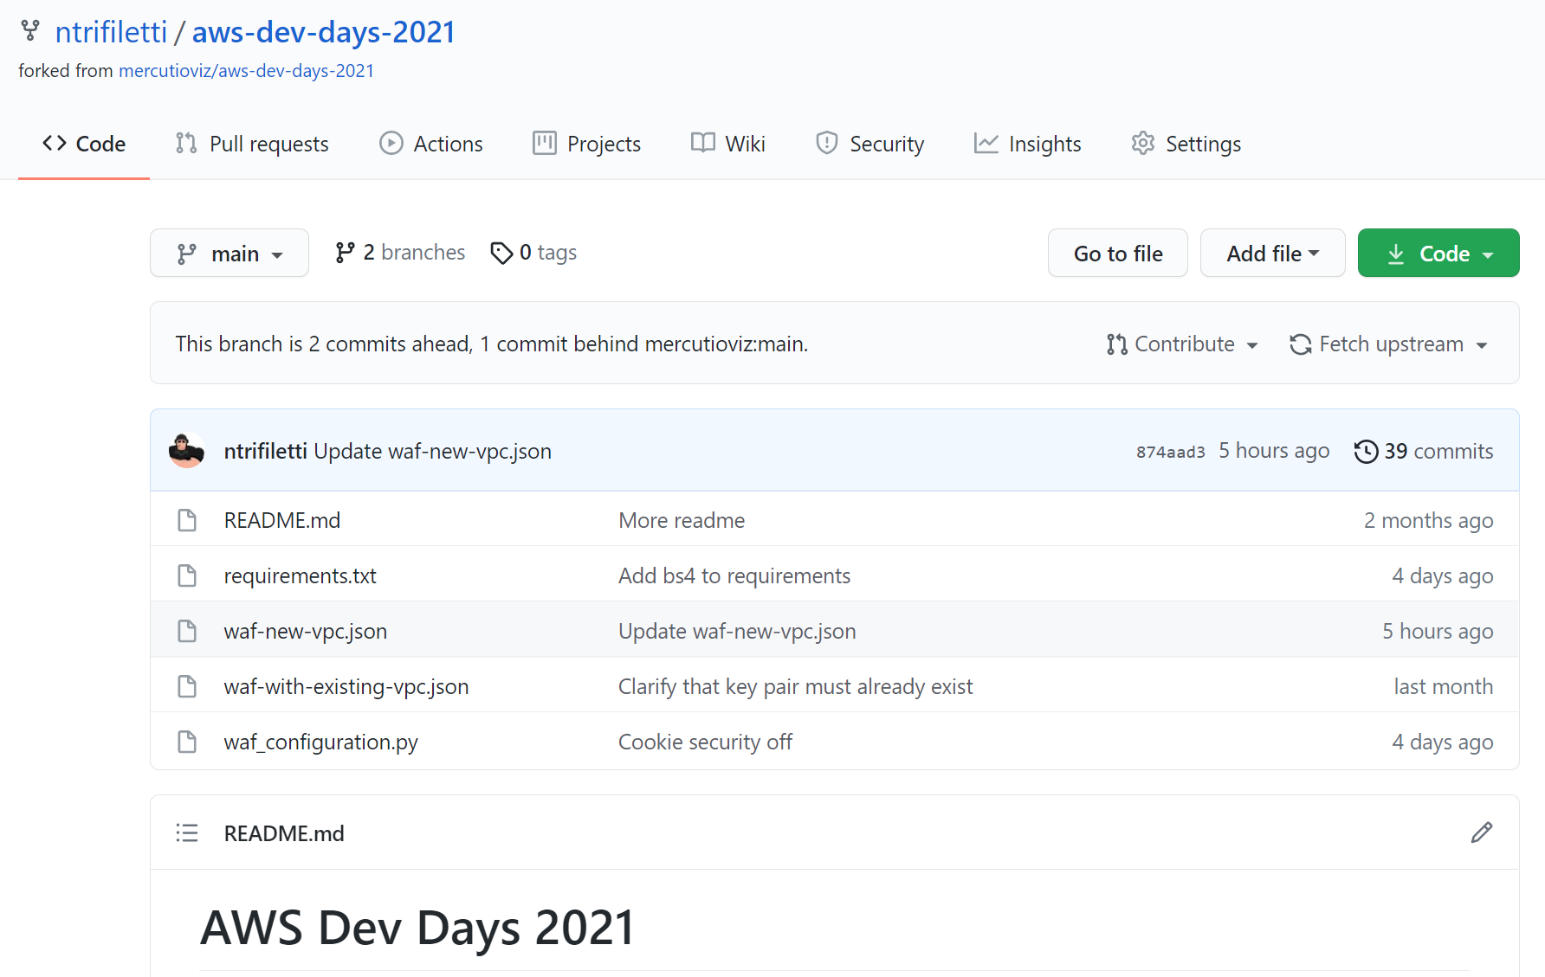

Slide 15

Resources
Learn
Contact
Try
Ask
Deploy the FREE 30-day evaluation of Barracuda’s Level 5, WAF in AWS by visiting: https://www.barracuda.com/download/products/web-application-firewall
Receive your $100 AWS credit code via email

Slide 16
Lab Access
The Lab Instructions are available here:
http://52.53.255.67/moodle/
Username: barracuda
Password: AWSDevdays123!

Slide 17
Next Steps

Slide 19
API Discovery and Security

Slide 20
OpenAPI File Import
Barracuda WAF parses through the swagger specs and extracts the data which can be used to configure API Security rules.
WAF Rules affected: JSON Profile, URL Profiles, Header ACLs
Enables brute force protection rules for rate limiting
Optionally enables Access Control
Request form | Path/ Form data/ Body | Query | Headers
WAF Rules | JSON Profile, key Profiles | URL Profile, param Profile | Header ACLs

Slide 21

Message Security: JSON Payload Inspection
JSON Security
API REQUEST
Content-Type: application/json
JSON Policy
JSON Profile
Client
Rule Violation
Key Profile
RESPONSE
Action Policy

Slide 22
Barracuda WAF API Security: Scope of Protection
DDOS
Exploits
Abuse
Access
In-Built DDoS prevention
Cloud Service based DDoS prevention
JSON Profiling
JSON key profiling
XML/SOAP Validation
WSDL Schema Validation
Bot Mitigation
IP Reputation check
Rate Controlling
Web Scraping protection
OpenID Connect SAMLv2

Slide 23
API Discovery
Identifying and securing APIs is a massive problem
Old API endpoints that are left unsecured can be very risky
Configuring API Security can be complex
Most API Gateways offer limited security capabilities
Lack of knowledge and complexity in setting up security is a barrier
First Steps to removing this complexity
API Discovery using configuration files
XML Schema validation / WS-I Security Validation
OpenAPI metadata file import for JSON Based API Validation

Slide 24
OWASP Top 10 API Threats
A1: Broken Object Level Authorization
A2: Broken Authentication
A3: Excessive Data
Exposure
A4: Lack of Resources and Rate limiting
A5: Broken Function Level Authorization
A6: Mass Assignment
A7: Security Misconfiguration
A8: Injection
A9: Improper Assets Management
A10: Insufficient Logging and Monitoring

